Slide 1
30 May 2023
Influence of Popularity on sales
FS2023: 63091 Social Media Analytics
CARONI Sophie / CAZZATO Emmanuel / NATER Quentin

Slide 2


content
Network source
Data loading
Pre-processing
Data quality
Community detection
Evaluation of the detection
exploration
Visualization
Persistence
Enrichment
Results

Slide 3



network Source and idea
719,150 nodes
Demonstrate if central nodes of communities are in the top rank sales
1’788’712 edges

Slide 4




Data loading
Amazon Standard Identification Number
List of similar products

Slide 5

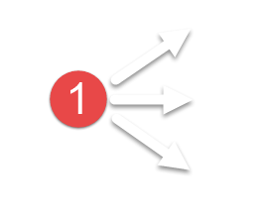
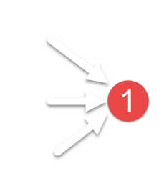
Pre-processing
While size reached
While size reached
If graph is changing
Remove isolated nodes
Remove not in-edged nodes
Remove not out-edged nodes
else
Remove the less degree nodes

Slide 6
Data quality - sampling
The quality of the graph samples
Datasets | Nodes | Edges | Runtime | Clustering Coefficient | Average Degree
amazon-meta.txt | 719'150 | 1'788'712 | 0:20.95 | 0.174 | 4.974
dataset_off_amazon_enrichment.txt | 189'825 | 613'464 | 0:03.69 | 0.333 | 6.463
dataset_off_amazon_big.txt | 126'981 | 527'243 | 0:02.31 | 0.495 | 8.304
dataset_off_amazon_small.txt | 60'707 | 260'472 | 0:01.22 | 0.562 | 8.581

Slide 7
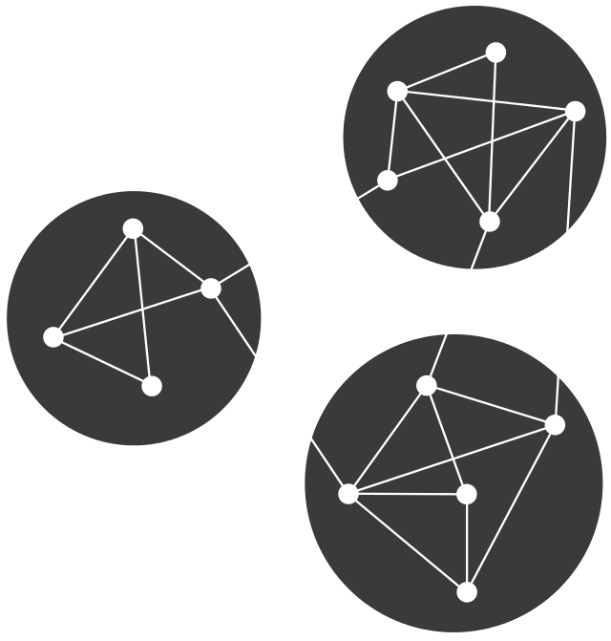

Network exploration
Connected ? Components ?
DFS
Efficiently explores interconnected books
Memory-efficient by fetching details on-the-fly
Potential to discover hidden relationships
A*
Guarantees optimal solutions
Utilizes heuristic evaluation for efficient exploration
Prioritizes promising paths

Slide 8
Network visualization
Clear and easy view of:
Clear and easy view of:
Degree Distribution of the while graph
Single community
Whole graph with communities in colours and central nodes in gold

Slide 9
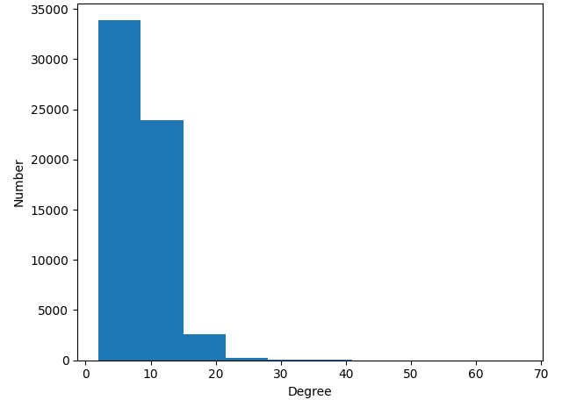
Network visualization – degree distribution
amazon_off_dataset_small.txt

Slide 10
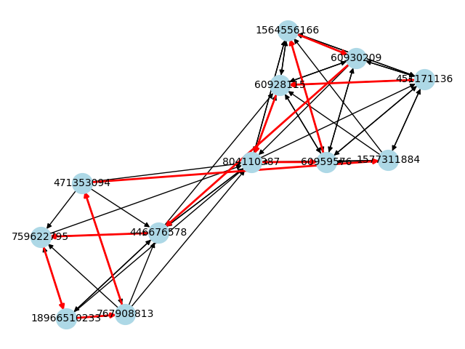
Network visualization – A community (exploration)

Slide 11
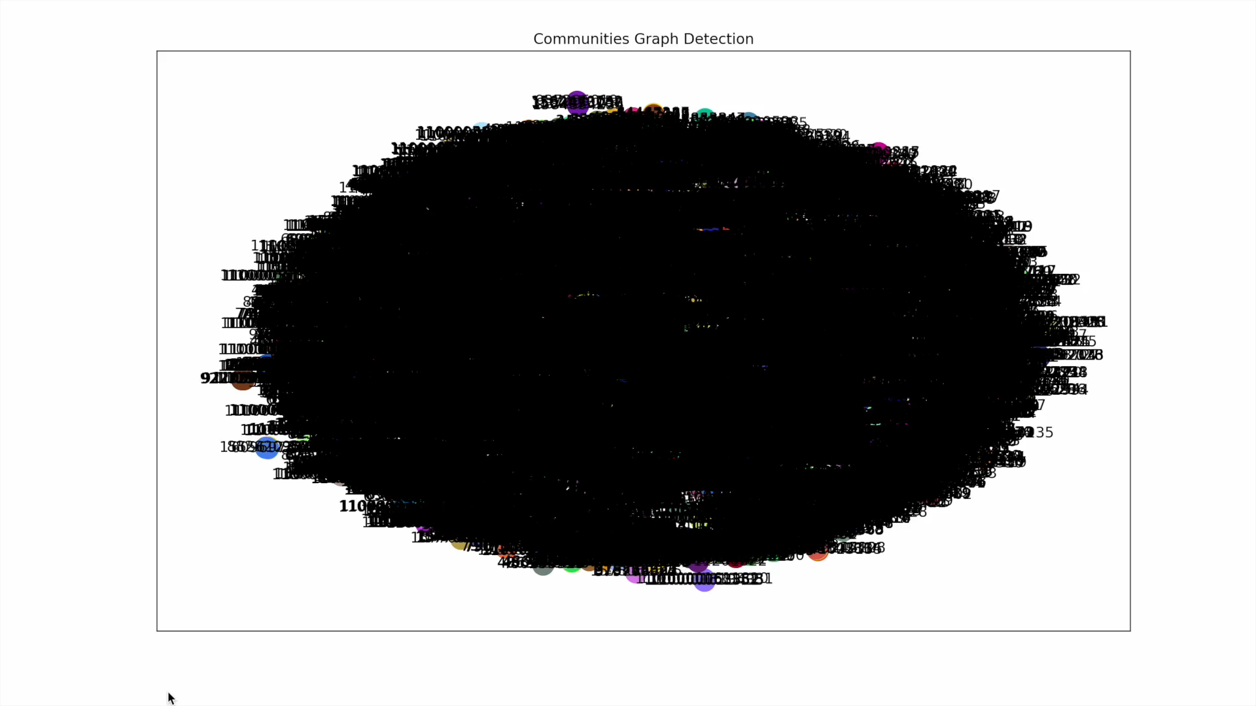
Network visualization – whole graph

Slide 12
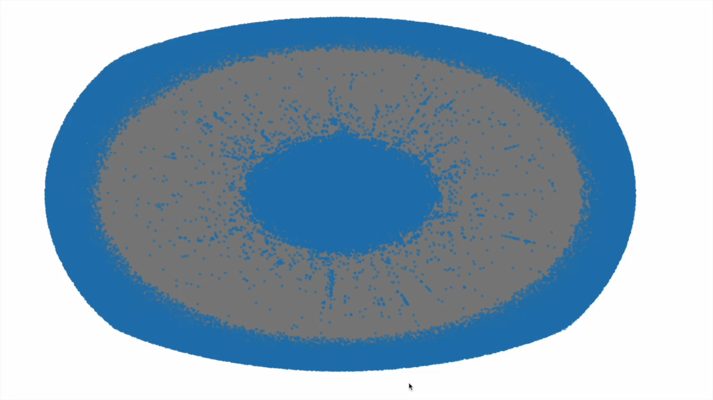

Network visualization - connectivity
Time to display
Notes:
Creating a C project from scratch.
Working with C language concepts. (Arrays, Pointers, Data Structures).
Incorporating resources from the internet.
Autonomously figuring out how to compile C code to different targets (microprocessor ESP8266 and TVOC/eCO2 Gas Sensor Unit (SGP30)). Get the values.
Runnable code, including testing scripts provided on GitLab with working automated build scripts (Gitlab CI).

Slide 13
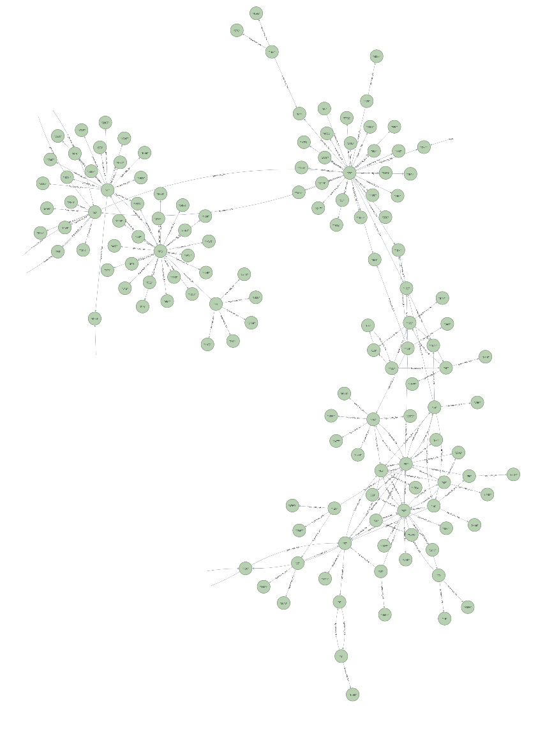
Graph persistence
Fast queries
Saved/Store
https://workspace-preview.neo4j.io/workspace/query

Slide 14
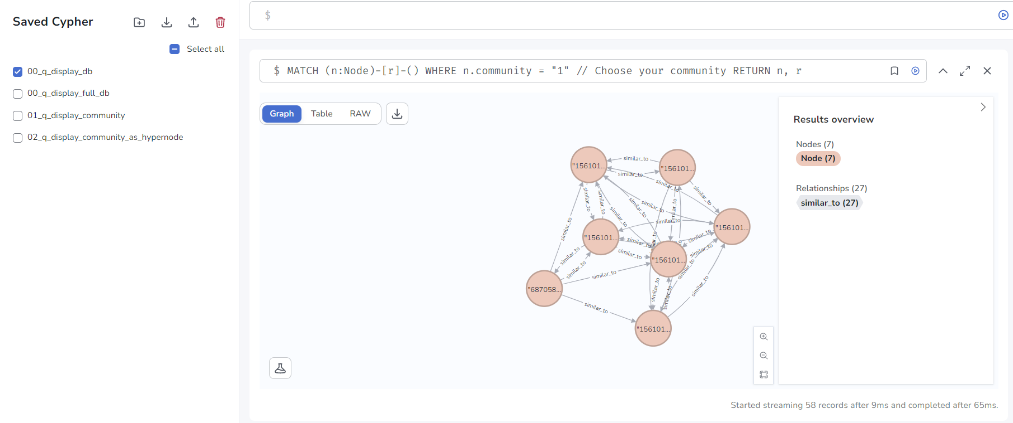
Graph persistence
https://workspace-preview.neo4j.io/workspace/query

Slide 15
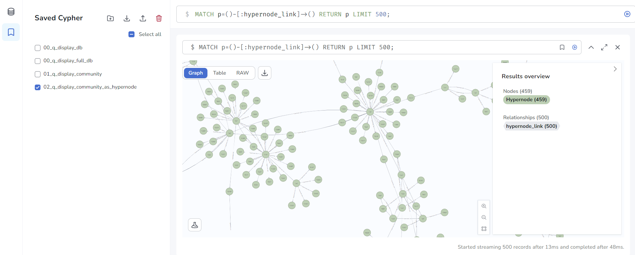
Graph persistence
https://workspace-preview.neo4j.io/workspace/query

Slide 16
Data enrichment
Find similar ASIN
Merge the two graphs
Have a better silhouette score
Take the better sampling

Slide 17
Community detection – Which Algo
Comparison of algorithms
datasets | Algorithm | Runtime | Silhouette Index | Communities
amazon_test | Louvain | 0:00.89 | 0.18 | 1580
amazon_test | Girvan Newman | > 2 days | - | -
amazon_test | Modularity | 0:01.38 | 0.26 | 1113

Slide 18


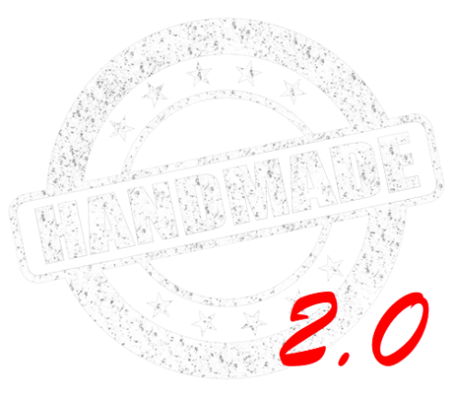
Community detection
Result
Runtime
New modularity
Weight directed
https://iopscience.iop.org/article/10.1088/1742-5468/2008/10/P10008/pdf

Slide 19
Evaluation of the community detection
The quality metrics of the community detection
Algorithms | Datasets | Runtime | Silhouette Idx | Accuracy | Precision | Recall | Jaccard | Communities
Simple Detection (homemade) | amazon_test | 0:40:15.93 | 0.21795 | 32.9% | 97.56% | 32.29% | 0.299 | 3’922
Simple Detection (homemade) | amazon_enrichment | > 2 days | - | - | - | - | - | -
Amazon Detection (homemade) | amazon_big | 0:00:12.8 | 0.05008 | 97.01% | 95.36% | 97.01% | 0.925 | 21,157
Amazon Detection (homemade) | amazon_ enrichment | 0:00:17.5 | 0.19851 | 97.54% | 89.76% | 97.54% | 0.875 | 17,818
NetworkX Louvain | amazon_big | 0:00:21.4 | 0.02363 | - | - | - | - | 23,521
NetworkX Louvain | amazon_enrichment | 0:00:17.7 | 0.08338 | - | - | - | - | 26,887

Slide 20

DEMOnstration

Slide 21
Conclusion - Technical
Easy to load and the sample
Better Community Detection Algorithm
Dataset enriched
Graph can be visualized and is store

Slide 22
Conclusion - Business
Better popular nodes of each community correspond to better sale ranks
Overall center of communities doesn't display the sale ranks
Amazon dataset can be analysed

Slide 23
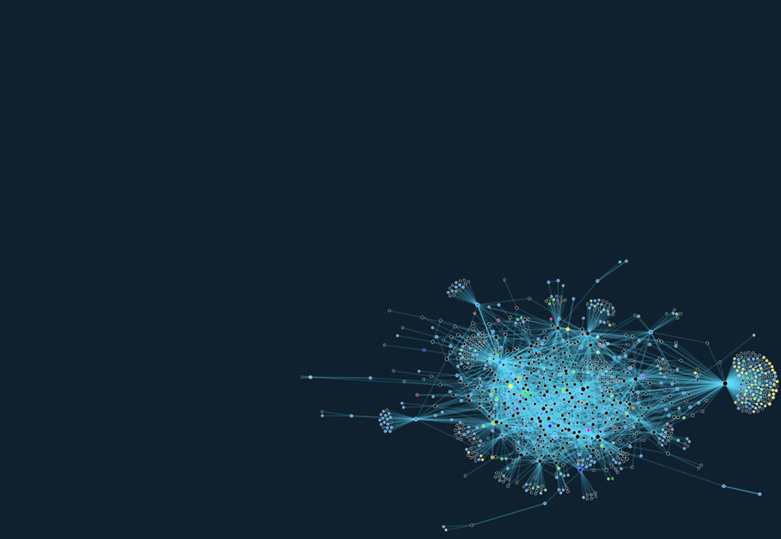

questions

